Slide 1
MSEE Short course on UQ
Outline
Introduction
Driving problems
Types of uncertainty
UQ framework
Probability theory
Set theory
Axiomatic definition
Random variables
Definition
Distribution functions
Moments of distribution functions
Joint distribution functions
Sampling methods
Monte Carlo methods
Crude Monte Carlo
Variance reduction methods
Stratified sampling methods
Importance sampling
Control variates

Slide 2
Driving problems

Slide 3
Types of uncertainty
Uncertainty
Decision
Aleatoric
Epistemic
Model
Parameter
We model uncertainty with probability!

Slide 4
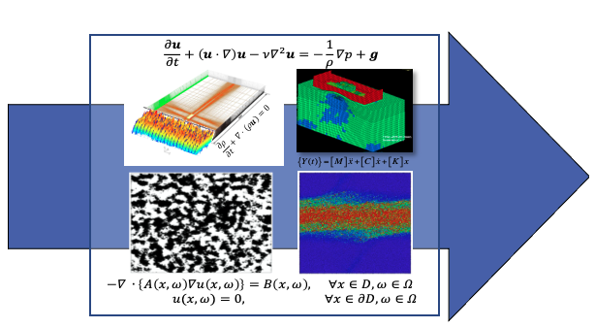
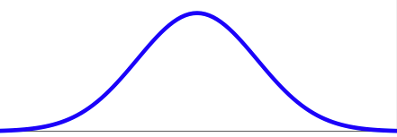
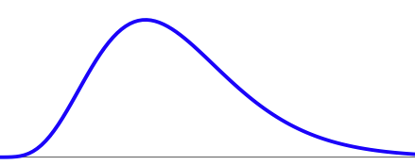
UQ framework
Forward UQ:
Q: "How does the uncertainty in the model inputs affects the uncertainty in the model outputs?"
Propagate uncertainty on input parameters through the model to obtain probability distribution of the output of interests
Input ξ
Quantity of Interest
(QoI)

Slide 5
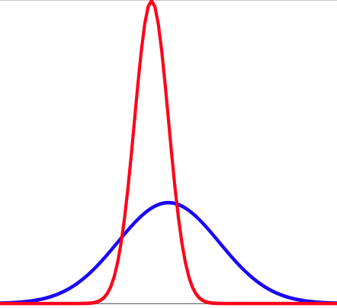
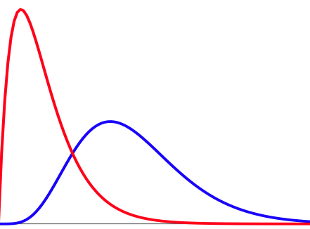
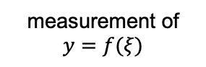
UQ framework
Inverse UQ:
Q: "What if I have experimental data?"
Quantify the uncertainty in the model inputs based on experimental data.
Input ξ
Quantity of Interest
(QoI)
measurement of $y=f(ξ)$

Slide 6
Probability theory
Probability is a measure that is associated with how certain we are about the outcome of an experiment or a mathematical tool to study randomness.
The origin of probability theory lies in physical observations associated with games of chance and was initially based on inductive reasoning (i.e., making broad realizations from observations).
Classical approach
Frequentist approach
It is as late as the beginning of the 20th century that a connection of probability theory to mathematical set theory was established, giving rise to the
Axiomatic approach

Slide 7
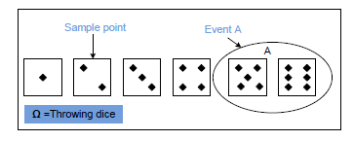
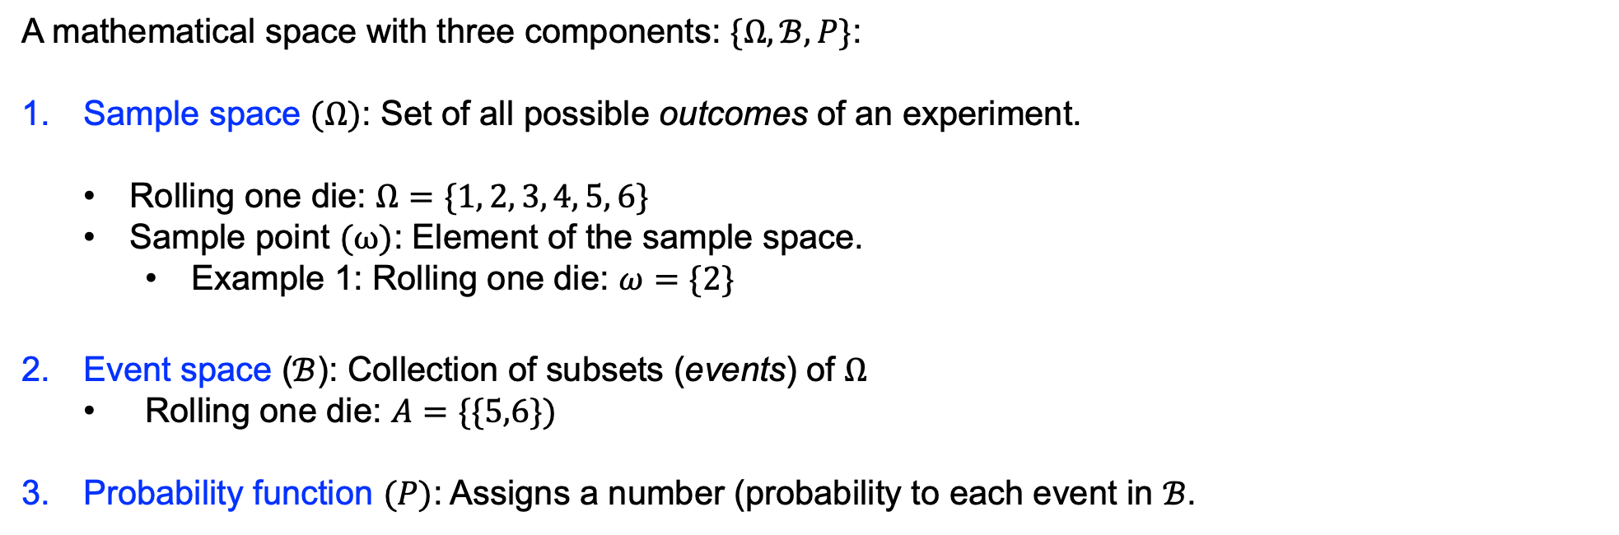


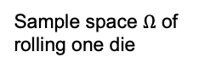
Probability theory
Probability space
A mathematical space with three components: $\{Ω, ℬ, P\}$:
Sample space $(Ω)$: Set of all possible outcomes of an experiment.
Rolling one die: $Ω=\{1, 2, 3, 4, 5, 6\}$
Sample point $(ω)$: Element of the sample space.
Example 1: Rolling one die: $ω=\{2\}$
Event space ($ℬ$): Collection of subsets (events) of $Ω$
Rolling one die: $A=\{\{5,6\})$
Probability function $(P)$: Assigns a number (probability to each event in $ℬ$.
Sample point $ω$
Event $A$
Sample space $Ω$ of rolling one die

Slide 8
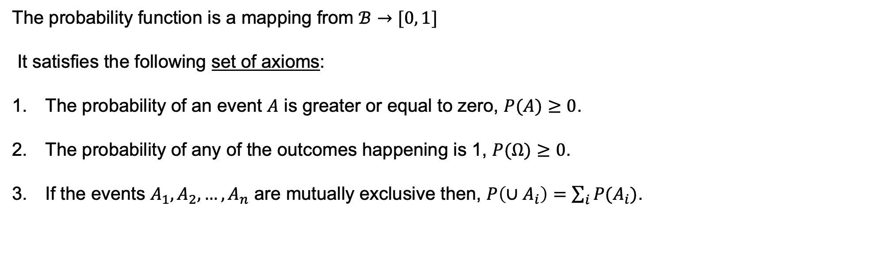
Probability theory
Axiomatic approach (Andrey Kolmogorov (1903-1987))
The probability function is a mapping from $ℬ→[0, 1]$
It satisfies the following set of axioms:
The probability of an event $A$ is greater or equal to zero, $P(A)≥0$.
The probability of any of the outcomes happening is 1, $P(Ω)≥0$.
If the events $A_{1},A_{2},…, A_{n}$ are mutually exclusive then, $P\left(∪A_{i}\right)=\sum_{i}{P(A_{i})}$.
Many important laws (e.g., Law of Large numbers) are derived from Kolmogorov’s three axioms.

Slide 9
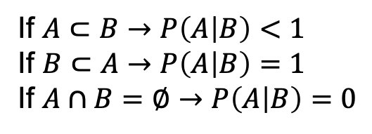
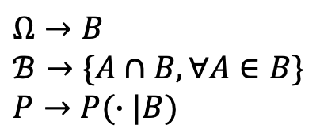
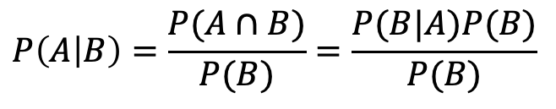
Probability theory
Conditional probabilities
Consider the probability space $\{Ω, ℬ, P\}$
If $A, B∈ℬ$ and $P(B)≥0$, then the conditional probability of $A$ given $B$ is:
If $A⊂B→$ $P\left(A | B\right)<1$
If $B⊂A→$ $P\left(A | B\right)=1$
If $A∩B=∅→$ $P\left(A | B\right)=0$
$$P\left(A | B\right)=\frac{P(A∩B)}{P(B)}=\frac{P(B|A)P(B)}{P(B)}$$
When you condition on event $B$ then, the $B$ becomes the sample space of the new probability space.
$Ω→$ $B$
$ℬ→$ $\{A∩B,∀A∈B\}$
$P→$ $P(∙|B)$

Slide 10
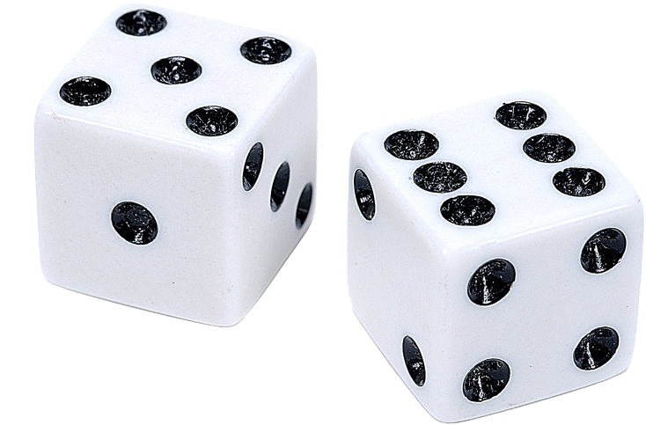
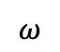

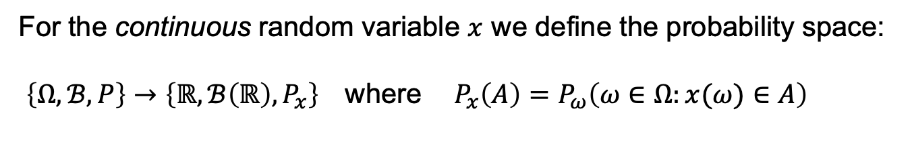

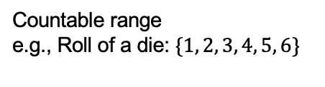
Random variables
Definition
A random variable is a function from the sample space $Ω$ to the real numbers $x: Ω→ℝ$
$$Ω$$
Discrete
Countable range
e.g., Roll of a die: $\{1, 2, 3, 4, 5, 6\}$
$$ω$$
$$ℝ$$
Continuous
Infinite range
For the continuous random variable $x$ we define the probability space:
$\left\{Ω, ℬ, P\right\}→\left\{ℝ, ℬ\left(ℝ\right), P_{x}\right\}$ where $P_{x}\left(A\right)=$ $P_{ω}\left(ω∈Ω:x(ω)∈A\right)$

Slide 11
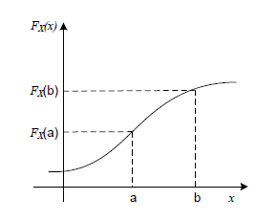
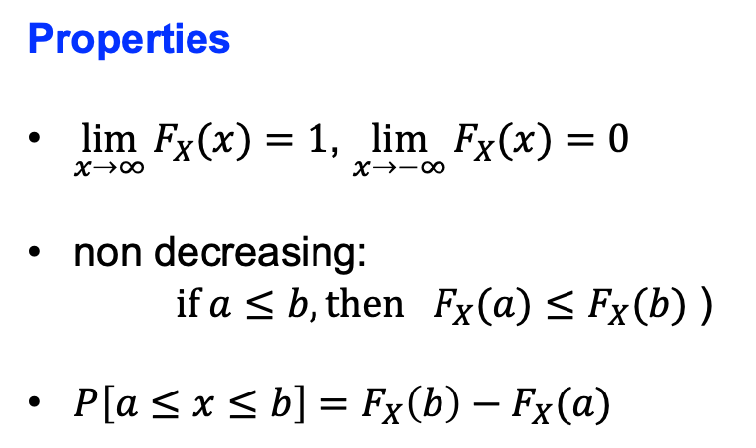
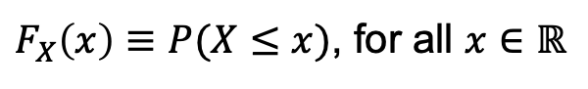
Random variables
Cumulative distribution function (cdf)
For a random variable (discrete and continuous) $X$ on a probability space we define its cumulative distribution function $F_{X}:ℝ→[0, 1]$ as:
$F_{X}\left(x\right)≡$ $P(X≤x)$, for all $x∈ℝ$
Properties
$\lim_{x→∞}{F_{X}(x)}=1$, $\lim_{x→−∞}{F_{X}(x)}=0$
non decreasing:
$if a≤b, then{ F}_{X}(a)≤F_{X}(b)$ )
$P\left[a≤x≤b\right]=$ $F_{X}\left(b\right)−F_{X}(a)$

Slide 12
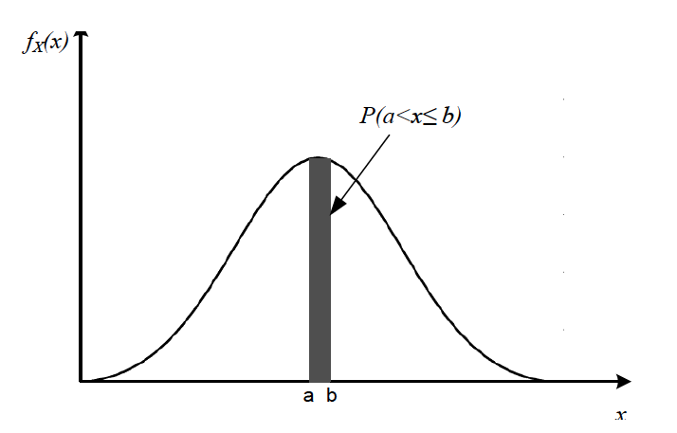
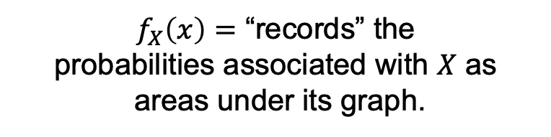
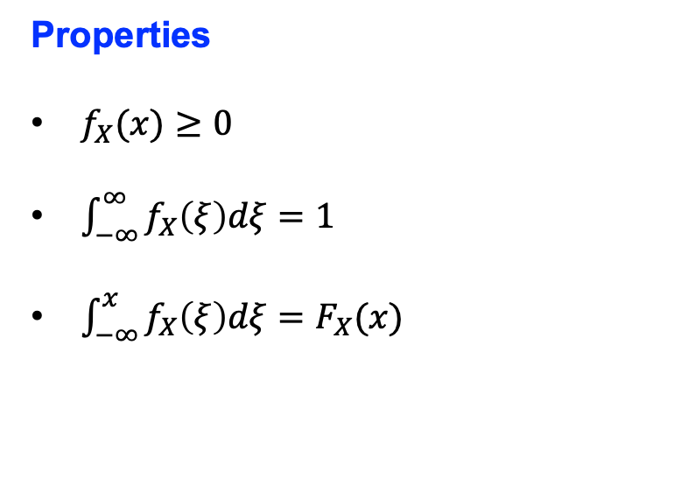
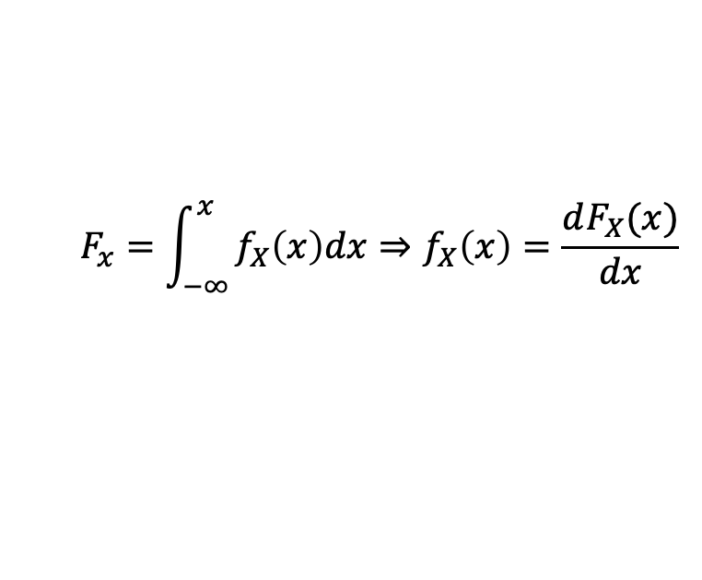
Random variables
Probability distribution function (pdf)
For a random variable $X$ on on a probability space we define the probability distribution function as:
$$F_{x}=\int_{−∞}^{x}{f_{X}\left(x\right)dx⇒f_{X}\left(x\right)=\frac{dF_{X}(x)}{dx}}$$
Properties
$f_{X}(x)≥0$
$\int_{−∞}^{∞}{f_{X}\left(ξ\right)dξ=1}$
$\int_{−∞}^{x}{f_{X}\left(ξ\right)dξ=F_{X}(x)}$
$f_{X}\left(x\right)=$ “records” the
probabilities associated with $X$ as
areas under its graph.

Slide 13
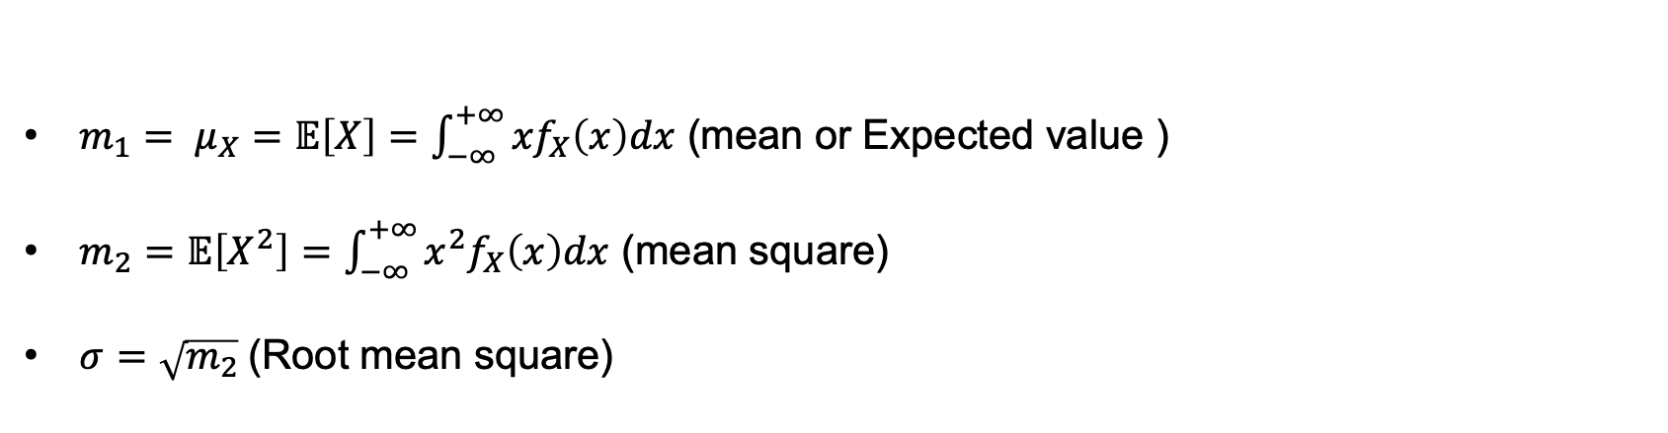
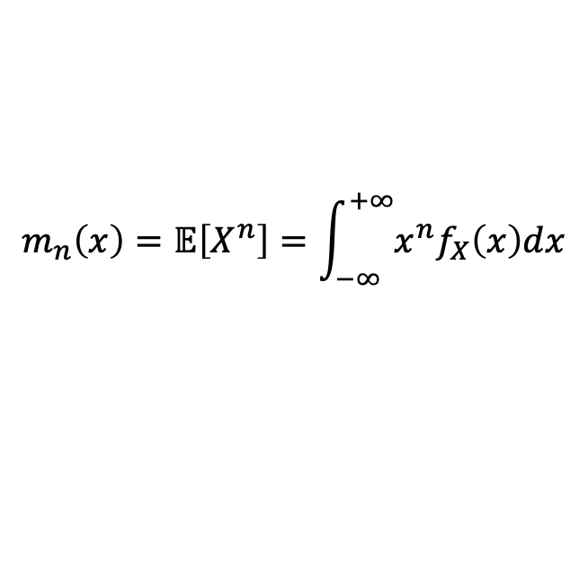
Random variables
Moments
For a random variable $X$ on a probability space we define moments as the expected values of its power of probability distribution function:
$$m_{n}\left(x\right)=𝔼\left[X^{n}\right]=\int_{−∞}^{+∞}{{x^{n}f}_{X}\left(x\right)dx}$$
$m_{1}= μ_{X}=𝔼\left[X\right]=\int_{−∞}^{+∞}{{xf}_{X}\left(x\right)dx}$ (mean or Expected value )
$m_{2}=𝔼\left[X^{2}\right]=\int_{−∞}^{+∞}{{x^{2}f}_{X}\left(x\right)dx}$ (mean square)
$σ=\sqrt{m_{2}} \text{(}\text{Root} \text{mean} \text{square}\text{)}$

Slide 14
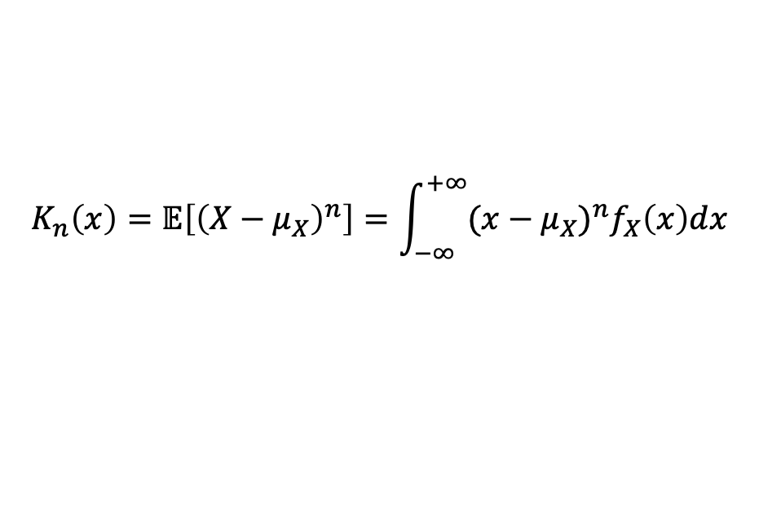
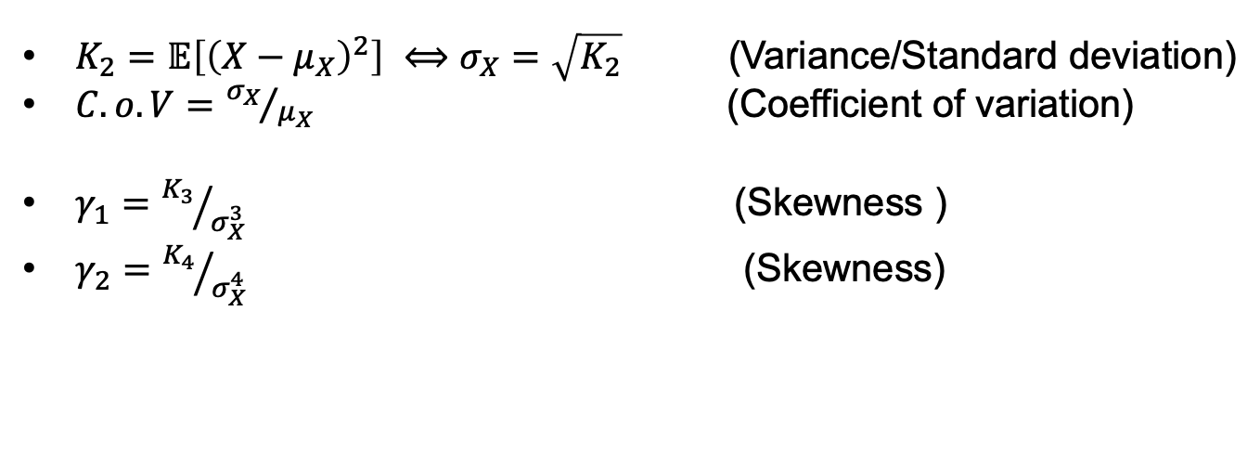
Random variables
Central Moments
For a random variable $X$ on a probability space we define moments as the expected values of its power of probability distribution function around its mean :
$$K_{n}\left(x\right)=𝔼\left[{\left(X−μ_{X}\right)}^{n}\right]=\int_{−∞}^{+∞}{{{(x−μ_{X})}^{n}f}_{X}\left(x\right)dx}$$
$K_{2}=𝔼\left[{\left(X−μ_{X}\right)}^{2}\right] ⟺σ_{X}=\sqrt{K_{2}}$ (Variance/Standard deviation)
$C.o.V={σ_{X}}/{μ_{X}} \text{(}\text{Coefficient} \text{of} \text{variation}\text{)}$
$γ_{1}={K_{3}}/{σ_{X}^{3}} \text{(}\text{Skewness}\text{ )}$
$γ_{2}={K_{4}}/{σ_{X}^{4}} \text{(}\text{Skewness}\text{)}$
Notes:
ss

Slide 15
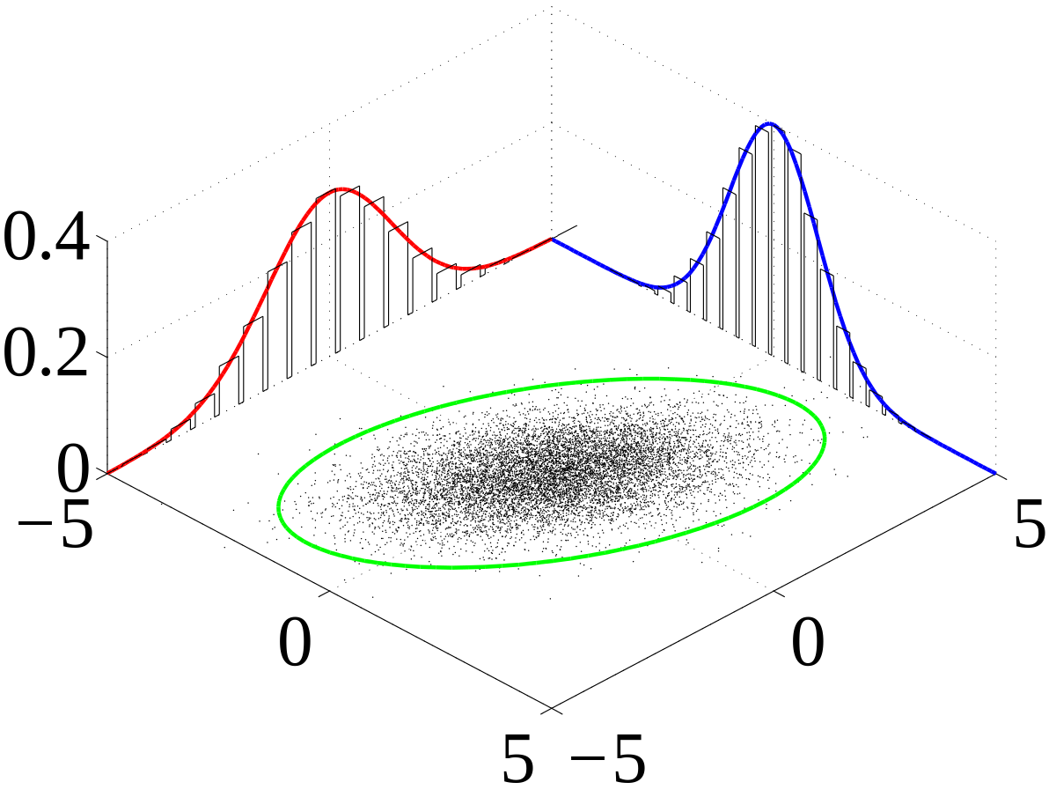
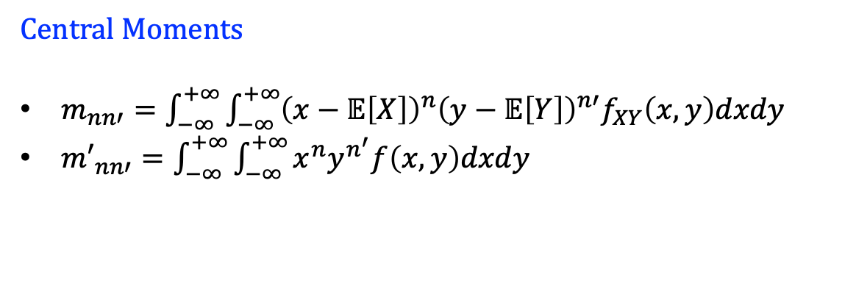
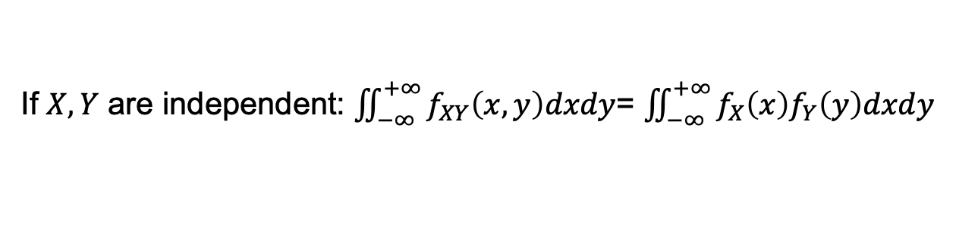
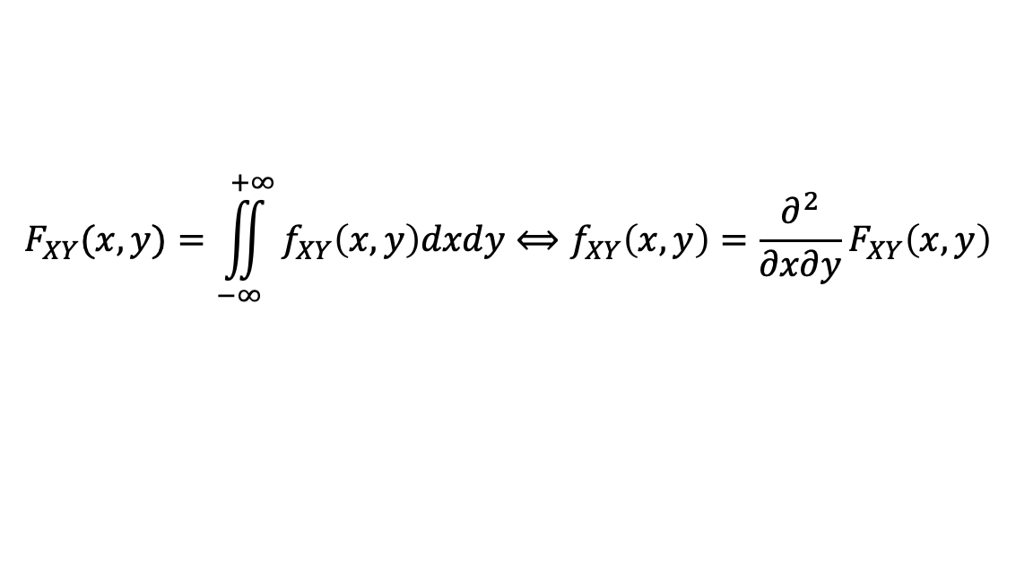
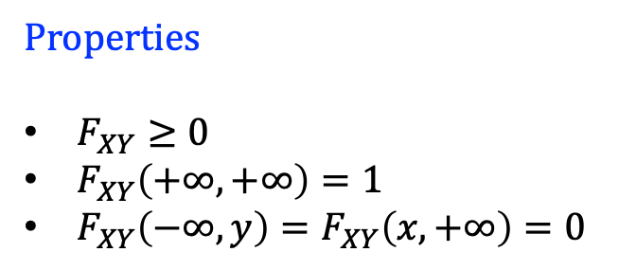
Random variables
Joint probability distribution function (pdf)
The simultaneous behavior of two continuous random variables $X, Y$ on a probability space is defined by the joint probability distribution function $F_{XY}:ℝ^{2}→{\left[0, 1\right]}^{2}$ : $F_{XY}\left(x, y\right)≡$ $P\left[\left(X≤x\right)∩\left(Y≤y\right)\right]$
$$F_{XY}(x, y)=\iint_{−∞}^{+∞}{f_{XY}\left(x, y\right)dxdy}⟺f_{XY}\left(x,y\right)=\frac{∂^{2}}{∂x∂y}F_{XY}\left(x,y\right)$$
If $X, Y$ are independent: $\iint_{−∞}^{+∞}{f_{XY}\left(x, y\right)dxdy}$= $\iint_{−∞}^{+∞}{f_{X}\left(x\right)f_{Y}\left(y\right)dxdy}$
Properties
$F_{XY}≥0$
$F_{XY}\left(+∞,+∞\right)=1$
$F_{XY}\left(−∞,y\right)=F_{XY}\left(x,+∞\right)=0$
Central Moments
$m_{nn′}=\int_{−∞}^{+∞}{\int_{−∞}^{+∞}{{\left(x−𝔼\left[X\right]\right)}^{n}{\left(y−𝔼\left[Y\right]\right)}^{n′}f_{XY}\left(x,y\right)dxdy}}$
${m′}_{nn′}=\int_{−∞}^{+∞}{\int_{−∞}^{+∞}{x^{n}y^{n^{′}}f\left(x,y\right)dxdy}}$

Slide 16
Sampling methods / Monte Carlo methods
Monte Carlo simulation (MCS) is a technique that tries to solve a problem for which an analytical solution does not exist by using random numbers.
“The Monte Carlo Method” by Metropolis and Ulam, 1949.
The Monte Carlo name is derived from the city, with the same name, in the Principality of Monaco, well known for its casinos. This was because the roulette wheel was the simplest mechanical device for generating random numbers.
Random (pseudo-random) numbers are generated according to a mathematical formula (e.g., mid-square method (John von Neumann), multiplicative congruential method (Lehmer)).
The performance of MCS is based upon the Law of Large numbers and the Central Limit theorem.

Slide 17
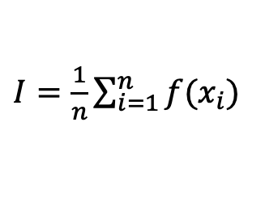
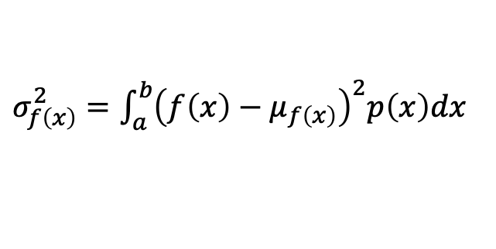
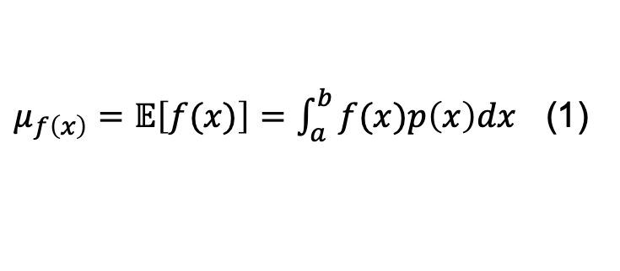
Sampling methods / Monte Carlo methods
MCS integration
Let $f\left(x\right)$ be a continuous function (variable) defined by probability distribution $p\left(x\right)$ in the interval $(a, b)$. Its expected value and variance are:
$μ_{f\left(x\right)}=𝔼\left[f(x)\right]=\int_{a}^{b}{f(x)p\left(x\right)dx}$ (1)
$σ_{f\left(x\right)}^{2}=\int_{a}^{b}{{\left(f\left(x\right)−μ_{f\left(x\right)}\right)}^{2}p\left(x\right)dx}$
We want to calculate the integral (1): Generate $n$ samples $x_{i}\sim q(x)$, $i=1, …, n$ and compute
$I=\frac{1}{n}\sum_{i=1}^{n}{f(x_{i})}$
Key components:
Law of large numbers.
Central Limit theorem

Slide 18
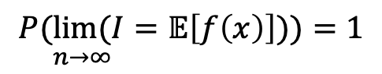
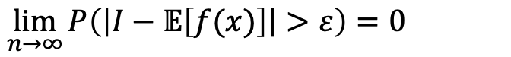
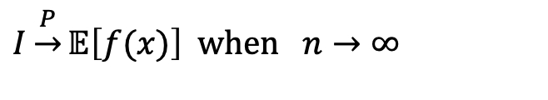
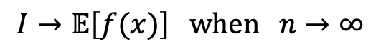
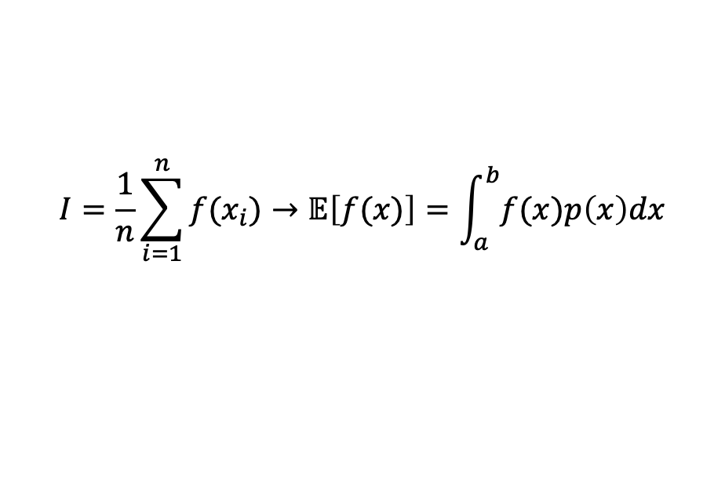
Sampling methods / Monte Carlo methods
Law of Large numbers
The Law of large numbers implies that the average of a sequence of $n$ random variables $x_{i}, i=1, …, n$, of a known distribution $p(x)$, converge to its expectation as the numbers of samples goes to infinity.
$$I=\frac{1}{n}\sum_{i=1}^{n}{f(x_{i})}→𝔼\left[f(x)\right]=\int_{a}^{b}{f(x)p\left(x\right)dx}$$
Strong law
Weak law
The average converges almost surely to the expected value
The average converges in probability towards the expected value
$$I→𝔼\left[f(x)\right] when n→∞$$
$$I\underset{→}{P}𝔼\left[f(x)\right] when n→∞$$
$$P(\underset{n→∞}{lim⁡(}I=𝔼\left[f\left(x\right)\right]))=1$$
$$\lim_{n→∞}{P\left(\left|I−𝔼\left[f(x)\right]\right|>ε\right)=0}$$
Notes:
)

Slide 19

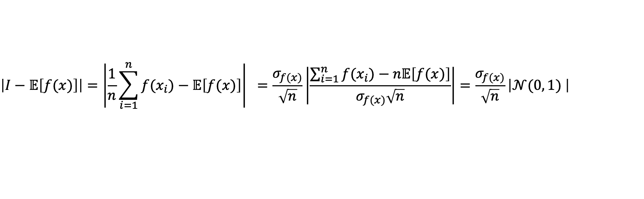
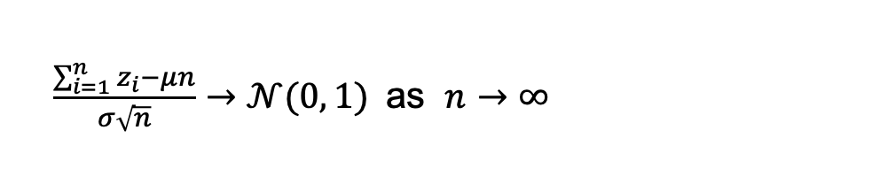
Sampling methods / Monte Carlo methods
Central Limit theorem
The Central Limit theorem implies that the sum of several independent random variables is approximately normally distributed. A sum of identical and independent distribution (i.i.d) random variables $z_{i}$ with mean $μ$ an finite variance $σ^{2}:$
$\frac{\sum_{i=1}^{n}{z_{i}−μn}}{σ\sqrt{n}}→𝒩(0, 1)$ as $n→∞$
Error in MC estimation
$$\left|I−𝔼\left[f(x)\right]\right|=\left|\frac{1}{n}\sum_{i=1}^{n}{f(x_{i})}−𝔼\left[f(x)\right]\right| =\frac{σ_{f(x)}}{\sqrt{n}}\left|\frac{\sum_{i=1}^{n}{f(x_{i})}−n𝔼\left[f(x)\right]}{σ_{f(x)}\sqrt{n}}\right|=\frac{σ_{f(x)}}{\sqrt{n}}\left|𝒩(0, 1) \right|$$
Notes:
)

Slide 20
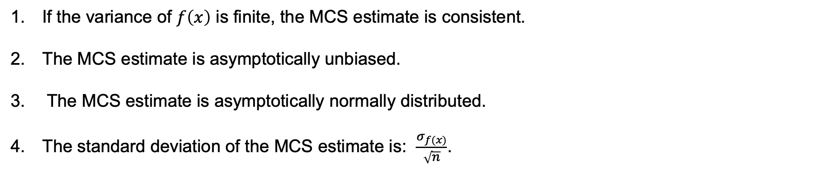
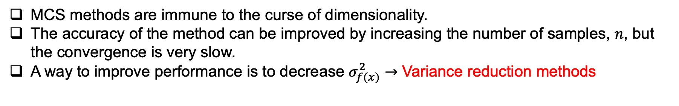
Sampling methods / Monte Carlo methods
Properties
If the variance of $f\left(x\right)$ is finite, the MCS estimate is consistent.
The MCS estimate is asymptotically unbiased.
The MCS estimate is asymptotically normally distributed.
The standard deviation of the MCS estimate is: $\frac{σ_{f(x)}}{\sqrt{n}}$.
MCS methods are immune to the curse of dimensionality.
The accuracy of the method can be improved by increasing the number of samples, $n$, but the convergence is very slow.
A way to improve performance is to decrease $σ_{f(x)}^{2}→$ Variance reduction methods
Notes:
)

Slide 21
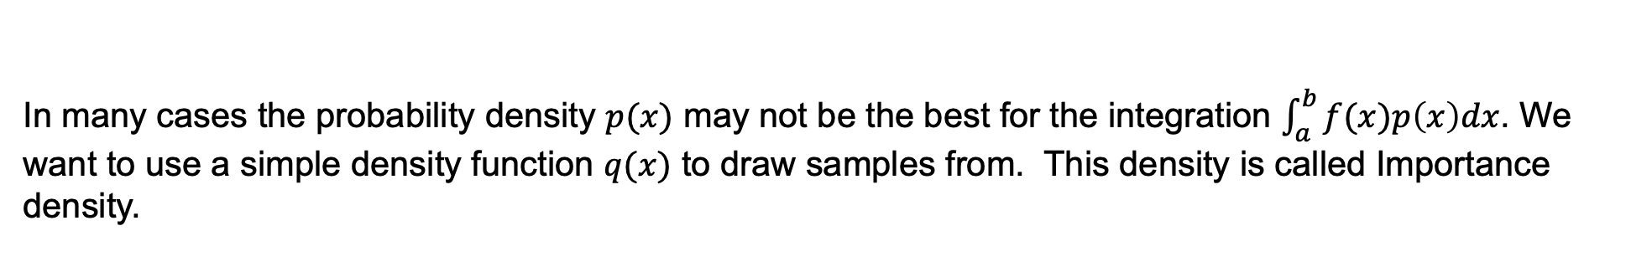

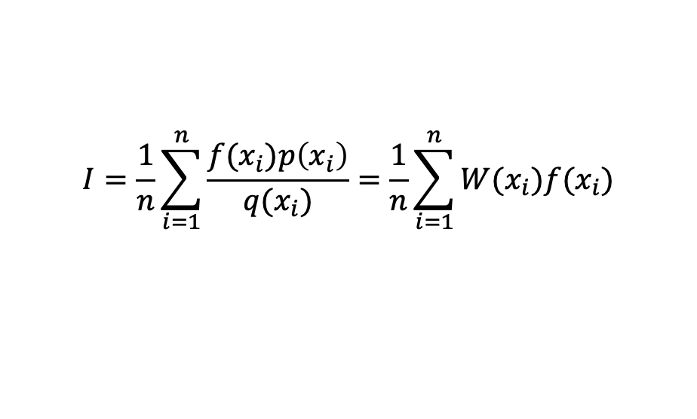
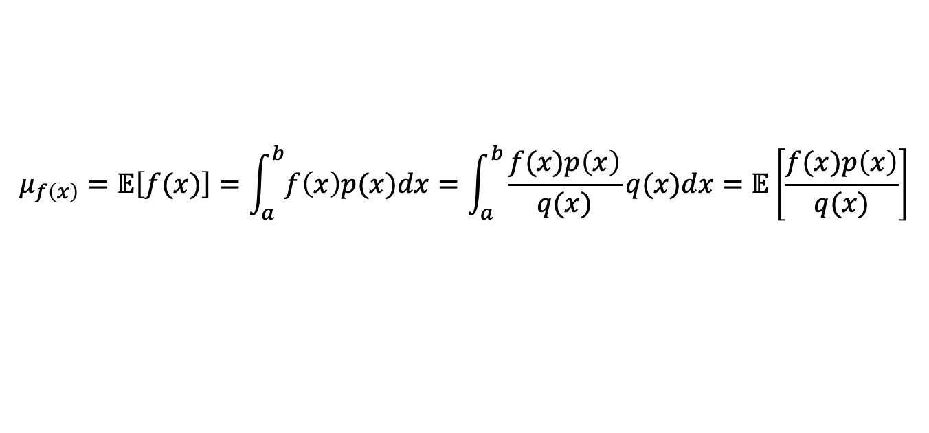
Sampling methods / Variance reduction methods
Importance sampling
In many cases the probability density $p(x)$ may not be the best for the integration $\int_{a}^{b}{f(x)p\left(x\right)dx}$. We want to use a simple density function $q(x)$ to draw samples from. This density is called Importance density.
$$μ_{f\left(x\right)}=𝔼\left[f(x)\right]=\int_{a}^{b}{f\left(x\right)p(x)dx}=\int_{a}^{b}{\frac{f(x)p\left(x\right)}{q(x)}q(x)dx}=𝔼\left[\frac{f(x)p\left(x\right)}{q(x)}\right]$$
In this case
$$I=\frac{1}{n}\sum_{i=1}^{n}{\frac{f(x_{i})p\left(x_{i}\right)}{q(x_{i})}}=\frac{1}{n}\sum_{i=1}^{n}{W(x_{i})f(x_{i})}$$
Where $W\left(x_{i}\right)=\frac{p\left(x_{i}\right)}{q(x_{i})}$ are called importance weights.
Notes:
)

Slide 22
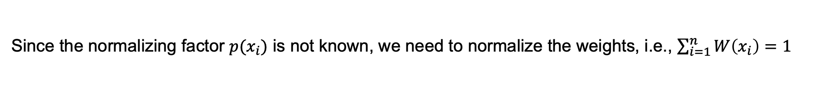
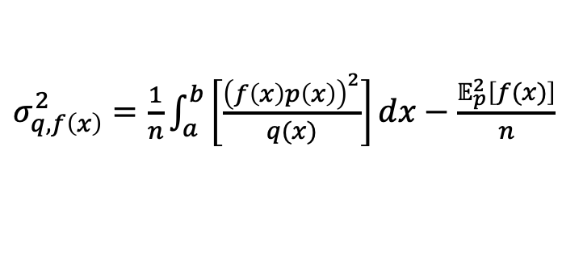


Sampling methods / Variance reduction methods
Importance sampling
Since the normalizing factor $p(x_{i})$ is not known, we need to normalize the weights, i.e., $\sum_{i=1}^{n}{W\left(x_{i}\right)=1}$
$$I=\frac{\frac{1}{n}\sum_{i=1}^{n}{W(x_{i})f(x_{i})}}{\frac{1}{n}\sum_{i=1}^{n}{W(x_{i})}}=\frac{1}{n}\sum_{i=1}^{n}{W_{n}(x_{i})f(x_{i})}$$
Where $W_{n}\left(x_{i}\right)=\frac{W\left(x_{i}\right)}{\frac{1}{n}\sum_{i=1}^{n}{W(x_{i})}}$ are called normalized importance weights. The estimate is biased but, the
bias vanishes as $n→∞$. The variance is given by:
$σ_{q, f\left(x\right)}^{2}=\frac{1}{n}\int_{a}^{b}{\left[\frac{{\left(f\left(x\right)p\left(x\right)\right)}^{2}}{q(x)}\right]}dx−\frac{𝔼_{p}^{2}\left[f(x)\right]}{n}$
Notes:
)

Slide 23





Sampling methods / Variance reduction methods
Importance sampling: Example
Suppose we have the function $f\left(x\right)=10exp⁡(−2\left|x−5\right|)$ and we want to approximate $μ_{f\left(x\right)}$ and $σ_{f\left(x\right)}^{2}$. The exact value of this integral is 1.
Case I. $p\left(x\right)=\frac{1}{10}\sim U\left(0, 10\right)$.
In this case we want to calculate the integral:
$$\int_{0}^{10}{10\exp\left(−2\left|x−5\right|\right)p(x)dx}$$
If we run brute force MCS with $n={10}^{5}$ samples $x_{i}$ from $p\left(x\right)$ we estimate:
$μ_{f\left(x\right)}=0.991$
$$σ_{f\left(x\right)}^{2}=3.32$$
$f\left(x\right)$ in this case is peaked at 5, and decays quickly elsewhere, therefore, under the uniform distribution, many of the points are contributing very little to this expectation.
$$f\left(x\right)$$
$$p\left(x\right)$$
Notes:
)

Slide 24






Sampling methods / Variance reduction methods
Importance sampling: Example
Case II. $p\left(x\right)=\frac{1}{10}\sim U\left(0, 10\right)$, $q\left(x\right)\sim 𝒩\left(5, 1\right)$
In this case we want to calculate the integral:
$\int_{0}^{10}{10\exp\left(−2\left|x−5\right|\right)\sqrt{2π}{\exp{\frac{(x−5)}{2}}}^{2}\frac{1}{\sqrt{2π}}\exp{\frac{−{\left(x−5\right)}^{2}}{2}}dx}$
Using $n={10}^{5}$ samples $x_{i}$ from $q\left(x\right)$ we estimate:
$$μ_{f\left(x\right)}=0.999, σ_{f\left(x\right)}^{2}=0.35≪3.32$$
$$f\left(x\right)$$
$$p(x_{i})/q(x_{i})$$
$$q(x_{i})$$
$$p\left(x\right)$$

Slide 25
Sampling methods / Variance reduction methods
Stratified sampling
Stratified sampling is a family of sampling methods that has been extensively used in the social sciences and financial mathematics owing to its ability to partition a population into strata that can be weighted, according to some probabilities.
“True” Stratified sampling (SS)
Partially stratified sampling (PSS)
Latinized partially stratified sampling (LPSS)
Latin Hypercube sampling (LHS)

Slide 26

Sampling methods / Variance reduction methods
Stratified sampling
In the spectrum of stratified sampling methods, the “true” stratified sampling and LHS lie at the opposite end (extremes).
[REF Shields]

Slide 27


Sampling methods / Variance reduction methods
Stratified sampling (SS)
Stratified sampling divides the probability space $Ω$ of each random variable $X$ into $k$ subspaces (strata) $R_{j}$ $j=1, …, k$, for which a MC integration is performed.
$$I=\sum_{j=1}^{k}{\int_{R_{j}}{f\left(x\right)p(x)dx}=}\sum_{j=1}^{k}{V_{j}∙\left(\frac{1}{n_{j}}\sum_{i=1}^{n_{j}}{f(x_{i})}\right)}$$
where $V_{j}≤1$ is the volume of the strata, i.e., the probability that a random sample will fall in stratum $R_{j}$ and $n_{j}$ is the number of random samples used for the integration on $R_{j}$. The variance is:
$σ_{f\left(x\right)}^{2}=\sum_{j=1}^{k}{\frac{V_{j}}{n_{j}}σ_{R_{j}, f\left(x\right)}^{2}}$ where $σ_{R_{j}, f\left(x\right)}^{2}=\frac{1}{V_{j}}\int_{R_{j}}{{\left(f\left(x\right)−\frac{1}{V_{j}}\int_{R_{j}}{f\left(x\right)p\left(x\right)dx}\right)}^{2}p\left(x\right)dx}$

Slide 28


Sampling methods / Variance reduction methods
Latin hypercube sampling (LHS)
Latin hypercube belongs in the family of stratified sampling methods. In this method, we divide the probability space of each variable $X$ into $k$ strata of equal marginal probability $p_{k}\left(x\right)=1/k$ and sample once from each stratum.
1-dimensional LHS
Evenly partition the CDF into $k$ regions.
Sample one point in each region.
Randomly
Center-wise
Avoid the probability samples coming from the same local region

Slide 29


Sampling methods / Variance reduction methods
Latin hypercube sampling (LHS)
Latin hypercube belongs in the family of stratified sampling methods. In this method, we divide the probability space of each variable $X$ into $k$ strata of equal marginal probability $p_{k}\left(x\right)=1/k$ and sample once from each stratum.
2-dimensional LHS
$X_{1}$ and $X_{2}$ must be independent.
Generate 1-dimensional LHS for each component.
Randomly combine the LHS samples by pairing.
One sample at each row and column

Slide 30



Sampling methods / Variance reduction methods
Control variates
It exploits information about the errors in estimates of known quantities to reduce the error of an estimate of an unknown quantity. Suppose we have the function $g\left(x\right)$ for which $𝔼[g\left(x\right)]$ is known. Let:
$$h\left(x\right)=f\left(x\right)− c\left(g\left(x\right)− 𝔼\left[g\left(x\right)\right]\right)$$
The estimate is given as
$$I=\frac{1}{n}\sum_{i=1}^{n}{\left(f\left(x_{i}\right)−cg\left(x_{i}\right)\right)+𝔼\left[g\left(x\right)\right]}$$
The variance of $h\left(x\right)$ is:
$$σ_{h\left(x\right)}^{2}=σ_{f\left(x\right)}^{2}+c^{2}σ_{g\left(x\right)}^{2}+2{COV}_{f\left(x\right),g(x)}$$
where
$${COV}_{f\left(x\right),g(x)}=\left(𝔼\left[f\left(x\right)−𝔼\left[f\left(x\right)\right]\right]\right)\left(𝔼\left[g\left(x\right)−𝔼\left[g\left(x\right)\right]\right]\right)$$

Slide 31





Sampling methods / Variance reduction methods
Control variates
We want to minimize the variance of $h\left(x\right)$ with respect to parameter $c$:
$$\frac{dσ_{h\left(x\right)}^{2}}{dc}=2cσ_{g\left(x\right)}^{2}+2{COV}_{f\left(x\right),g(x)}=0$$
This will give
$$c^{∗}=−\frac{{COV}_{f\left(x\right),g(x)}}{σ_{g\left(x\right)}^{2}}$$
$$σ_{h\left(x\right)}^{2}=σ_{f\left(x\right)}^{2}−\frac{{COV}_{f\left(x\right),g(x)}}{σ_{g\left(x\right)}^{2}}=σ_{f\left(x\right)}^{2}\left(1−ρ_{f\left(x\right),g(x)}^{2}\right)$$
The variance of $h\left(x\right)$ becomes:
With correlation coefficient
$$ρ_{f\left(x\right),g(x)}^{ }=\frac{{COV}_{f\left(x\right),g(x)}}{σ_{f\left(x\right)}^{ }{∙σ}_{g\left(x\right)}^{ }}$$

Slide 32


Sampling methods / Variance reduction methods
Control variates: Example
Suppose we have the function $f\left(x\right)=1/{1+x}$ and we want to approximate $μ_{f\left(x\right)}$ and $σ_{f\left(x\right)}^{2}$ using MC integration. The exact solution for $p\left(x\right)=1\sim U\left(0, 1\right)$ is $μ_{f\left(x\right)}=0.693$.
In this case we want to calculate the integral:
$$\int_{0}^{1}{\frac{1}{1+x}p(x)dx}⟺I=\frac{1}{n}\sum_{i=1}^{n}{f(x_{i})}$$
If we run brute force MCS with $n=1500$ samples $x_{i}$ from $p\left(x\right)$ we estimate:
$μ_{f\left(x\right)}=0.694$
$$σ_{f\left(x\right)}^{2}=0.019$$
Notes:
)

Slide 33



Sampling methods / Variance reduction methods
Control variates: Example
If we introduced $g\left(x\right)=1+x$ as a control variate with know expected value $𝔼\left[g\left(x\right)\right]=\int_{0}^{1}{\left(1+x\right)dx=\frac{3}{2}}$ the expectation becomes:
$$I=\frac{1}{n}\sum_{i=1}^{n}{f\left(x_{i}\right)+c\left(\frac{1}{n}\sum_{i=1}^{n}{g\left(x_{i}\right)−\frac{3}{2}}\right)}$$
If we run brute force MCS with estimated $c=0.4773$ and $n=1500$ we estimate:
$μ_{f\left(x\right)}=0.692$
$$σ_{f\left(x\right)}^{2}=0.0006$$
Notes:
)

